Slide 1
Diving into Aging Research (Funding, Careers, Etc.)
Amelia Karraker (Amelia.Karraker@nih.gov)
Health Scientist Administrator, NIA
EdDem Network
September 16, 2024

Slide 2
Today’s Talk
Please ask questions along the way
Outline:
NIH/NIA/DBSR overview
NIA training/career opportunities
General application tips
Q&A throughout

Slide 3
NIH Terminology
IC = NIH Institute or Center (e.g., National Institute on Aging, Fogarty International Center): different ICs may have different policies/procedures
Mechanism = grant (most common), cooperative agreement, contract
Activity Code = F31, F32, T32, K01, K99/R00, R01, R21
NOFO = Notice of Funding Opportunity Announcement (PA, NOT, PAR, PAS, RFA)

Slide 4
Notices of Funding Opportunity (NOFO)
Notices of Funding Opportunity (NOFO) and Notices of Special Interest (NOSI) are the primary ways that NIH institutes solicit new research.
NOFOs/NOSIs explain the research priority area and provide guidance on application requirements.
The details matter – what you can ask for (budget, time, activity), what reviewers will consider when assessing the science, and how the NIH will make awards.
Most science is funded out of “parent announcements” on investigator-identified topics (e.g., PA-20-185)

Slide 5
Question: When to submit a proposal via the regular R01 PAR vs. a NOSI (e.g., pros/cons or strategic considerations)?
Read NOFO carefully for info about participating ICs, eligibility, due dates, budgets, project periods, review criteria, etc.; many list Scientific Contact (PO) who you can email about details
PA—used for “parent” announcements (i.e. R01 on investigator-initiated topic; PA-20-185)
PAR—special review panel, may be special responsiveness and review criteria (PAR-19-070) (“R is for review”)
PAS—set-aside funds ($$$!) (PAS-19-391) (“PAS=PA$$$$”)
RFA—set-aside funds, special review/responsiveness (RFA-AG-18-011)—typically only 1 receipt date
NOSI=Notice of Special Interest—replacing PA in many cases “FYI” to research community (NOT-AG-20-038)

Slide 6
About the NIH and NIA
The National Institutes of Health (NIH) is largest public biomedical funder in the world.
The National Institute on Aging is one of the 27 institutes and centers of the National Institutes of Health - understand the nature of aging and extend the healthy, active years of life
Notes:
First, about the Division of B&S research.

Slide 7
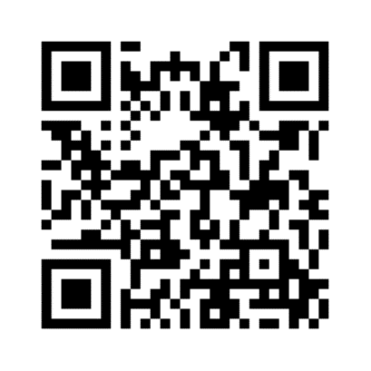
About the Division of Behavioral and Social Research (BSR)
The Division of Behavioral and Social Research (DBSR) is an extramural division of NIA focusing on social, behavioral, and economic research, research infrastructure and research training on the processes of aging at the individual and societal level
Cross-disciplinary research at multiple levels from genetics to cross-national comparative research, and at stages from basic through translational
Alzheimer’s disease and Alzheimer’s disease-related dementias (AD/ADRD) research in addition to life course health and aging research
Science managed across two research branches:
Population and Social Processes: Demographic, social, economic, institutional, geographic, and other factors at the population level including nationally representative longitudinal studies
Individual and Behavioral Processes: Psychological, behavioral, and interpersonal processes at the individual and dyadic level; interventions
Notes:
First, about the Division of B&S research.

Slide 8
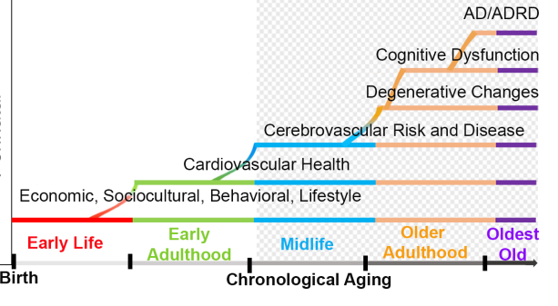
NIA and Alzheimer’s Disease and Alzheimer’s Disease Related Dementias (AD/ADRD)
Adapted from ADRD Summit 2022
NIA is the lead federal agency for AD/ADRD
AD/ADRD unfolds across the life course

Slide 9
Question: What are the NIA’s priorities? What does NIA see as the future of aging research funding?
NIA Strategic Directions (selected below)
Goal B: Better understand the effects of personal, interpersonal, and societal factors on aging, including the mechanisms through which these factors exert their effects
Goal F: Understand health disparities related to aging and develop strategies to improve the health status of older adults in diverse populations
Input sought on NIA 2026-2030 Strategic Directions
AD+ADRD Milestones
BSR 2019 NACA Review

Slide 10
Selected AD+ADRD Milestones Tied to NIA Priorities
1.B. Population Studies: Quantify the exposome
1.C. Population Studies: Diverse cohorts
1.F. Population Studies: Inclusion of non-AD cohorts
1.I. Health Equity: Identify risk factors across diverse populations
1.J. Health Equity: Monitor trends of different ADRDs in diverse populations
1.P. Population Studies: Exposome studies and health disparities
1.S. Health Equity: Understand and reduce barriers to health equity

Slide 11
2019 National Advisory Council on Aging Review of Division of Behavioral and Social Research
Review of Division activities for past 5 years, roadmap for next 5 years
Review-identified research priorities include:
Improve understanding of health disparities in aging.
Study influences of macro-social trends on aging.
Incorporate a range of approaches to understanding behavioral and social aging.
Enhance research on cognitive aging.
Support research to improve care for persons with dementia and caregivers.
Study aging earlier in the life course.
Emphasize multidisciplinary training including policy relevance.
Reduce barriers to accessing data for research.
Notes:
2019 BSR NACA Review

Slide 13
Question: Please expound upon the R25/K01 REDI program.
NIA Research and Entrepreneurial Development Immersion (REDI)
Provides bio-entrepreneurship training to boost the number of university startups and facilitate more diverse career opportunities for early-career scientists working in the fields of aging and aging-related diseases, including Alzheimer’s disease.
REDI Mentored Entrepreneurial Career Development Award (PAR-22-227)
REDI Entrepreneurship Enhancement Award (PAR-22-226)
Email niatraining@mail.nih.gov for more info

Slide 14
Question: Is there a particular sequence one needs to consider the following grant mechanisms: NIA K01 and NIA R03 and why or why not? (Assuming you cannot have K01 and R03 under review at the same time).
Answer: Not necessarily!
Eligibility for K01: cannot have previously held R01, but ok to hold R03, R21 (check “Eligible individuals ((Program Director/Principal Investigator)”)
You cannot have the same science under review in multiple places simultaneously

Slide 15
Lots of resources on training and career opportunities on the web
Detailed information on purpose, eligibility, budget, etc. for specific activity codes
Info on training events, NIH loan repayment program
Some sample applications
niatraining@mail.nih.gov

Slide 16
NIH/NIA funds secondary data analysis projects…and supports data sources for this purpose

Slide 17
When to Talk to a Program Official/Project Officer (PO)
When you are preparing to submit/have a great idea but want broad feedback, advice on NOFO or activity code (e.g. R01 v. K01?), Study Section, need advance permission for large application
After summary statement is issued
Post-award for updates, discussion about supplements, renewals

Slide 18
Specific Aims Page: Basis of Conversations with POs and Applications
Outlines application significance, hypotheses, data, methods at high-level—don’t bury the lede!
Gestalt of what you propose to do
No magic number of aims—should be appropriate for activity code, budget, project period
“Do less better”: far preferable to have 2 good aims than 3 so-so aims

Slide 19
Question: In addition to online resources and other factors, how would you advise a first time R01 participant to approach a successful grant submission -- in terms of spending time on specific sticking points or things that might set it apart?
Answer: see next few slides!

Slide 20
Application Tips
Look at successful application examples if available (e.g., NIA K99/R00, various at NIAID)
Read NOFO carefully
Talk with PO before submission
From application submission to Notice of Award minimum of 9 months

Slide 21
More Application Tips
Grantsmanship matters—be clear and coherent, use visual cues to guide the reviewer through your application—find examples online
Be honest about the weaknesses of your work—acknowledging them shows your sophistication (and reviewers will find them anyways); propose strategies to address
Secondary data analyses are funded, including for R01s
R01s have higher standard in terms of expectations of preliminary data, but provide it if you have it

Slide 22
Even More Application Tips
Provide power analyses (if applicable) across activity codes
Don’t neglect conceptual model
Write the most rigorous, innovative, and high-impact application you can
If you say someone outside your institution will do something, get a letter of support confirming this
General guiding questions:
“Does this application address an important scientific question/problem?” (Significance)
“Will the data, methods, measures used yield a rigorous answer to this question?” (Approach)

Slide 23
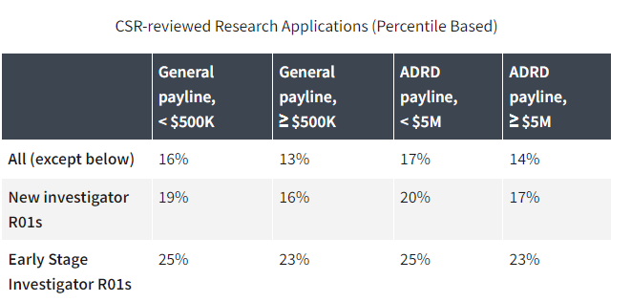
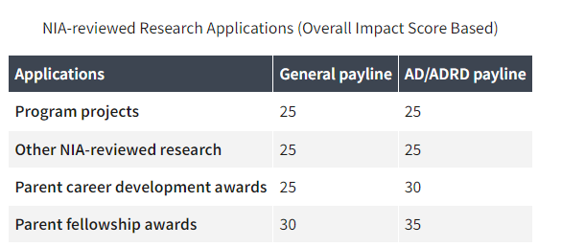
Question: What are the expected funding lines for the next few years? What are the pros and cons of applying for an R21 vs. an R01 if you are an early-career researcher who hasn't won a big grant before?
Based on appropriations
Specific lines depend on NOFO, review location, activity code
RFAs paid by set-aside

Slide 24
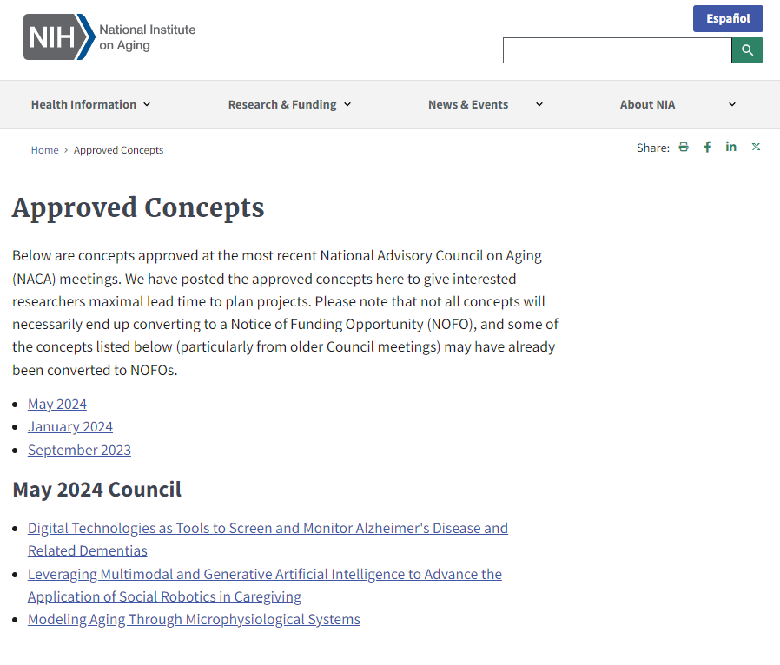
NACA Approved Concepts may develop into RFAs, etc. (NOFOs with set-aside funds and special review)
Notes:
This Photo by Unknown Author is licensed under CC BY-ND

Slide 25
Selected Active NOFOs
NOT-AG-24-004: Notice of Special Interest (NOSI): U.S. Health in the International Perspective (nih.gov)
Standard dates through May 08, 2027
Contact Dr. Kriti Jain
RFA-AG-25-003: Research Collaboration Network in Structural Racism Measurement and Modeling (U24 Clinical Trial Optional)
Applications due October 17, 2024
Contact Dr. Frank Bandiera

Slide 26
Diversity and re-entry supplements
Diversity supplement program support the development of eligible* trainee-candidates who seek independent and productive careers in research on aging and enhance diversity in the biomedical workforce.
Re-entry and Re-Integration Supplement program supports eligible individuals in reentering an active research career after life events have placed their research careers on hold.
Accepted on a rolling basis, decisions typically within 2-3 months of receipt
*candidates from groups that are underrepresented in the biomedical, clinical, behavioral and social sciences, such as, individuals from underrepresented racial/ethnic groups, with a disability, and/or from disadvantaged backgrounds

Slide 27
Butler-Williams Scholars Program
U.S. citizen, non-citizen national, or permanent resident with doctoral degree interested in health disparities and aging research
Application available spring ‘25 for Summer ’25—subscribe to Inside NIA Blog for announcement
Presentations/meetings with NIA grantees, NIA leadership, and Program Officials; mock review; networking opportunities

Slide 28
STAY IN THE KNOW
Subscribe to NIH Guide, Inside NIA Blog

Slide 29
Thanks!
Email: amelia.karraker@nih.gov

